Slide 1
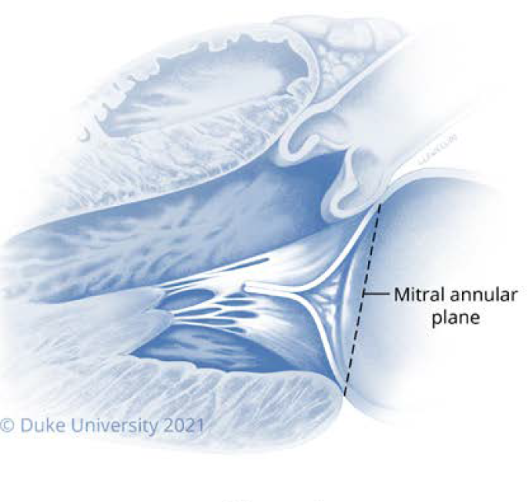
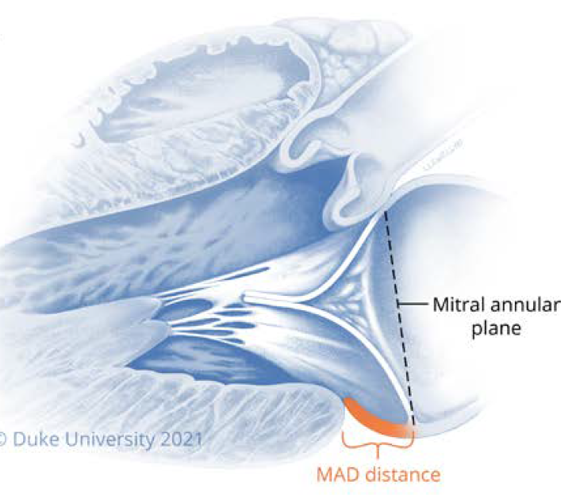
Mitral Annular Disjunction
Abnormality of the mitral annulus in which a portion of the mitral valve (MV) leaflets insert into the atrial wall at a point distant from the junction of the left atrial and left ventricular myocardial tissue
1981 – Bharati et al
Notes:
A growing body of literature suggests an association between MAD and ventricular arrhythmias, including sudden cardiac death (SCD).

Slide 2
References
^{c}
FunctionalImplicationofMitralAnnularDisjunctioninMitralValveProlapse AQuantitativeDynamic3DEchocardiographicStudy AlexPuiWaiLee,MD,
Imaging Considerations and Clinical Implicationsof Mitral Annular Disjunction
Caitlin S. Drescher , MD; Michelle D. Kelsey , MD; George S. Yankey, MD; Albert Y. Sun, MD; Andrew Wang , MD;Anita Sadeghpour , MD; Donald D. Glower Jr, MD; Sreekanth Vemulapalli , MD; Anita M. Kelsey, MD
Myocardial deformation in malignant mitral valve prolapse: A shifting paradigm to dynamic mitral valve–ventricular interactions
Tricuspid Annulus Disjunction: Novel Findings by Cardiac Magnetic Resonance in Patients With Mitral Annulus Disjunction
Mitral annulus disjunction is associated with adverse outcome inMarfan and Loeys–Dietz syndromes Monica Chivulescu1,2, Kirsten Krohg-Sørensen2,3, Esther Scheirlynck1, Beate R. Lindberg3, Lars A. Dejgaard1,2,4, Øyvind H. Lie1,2, Thomas Helle-Valle1, Eystein T. Skjølsvik1,2, Mette E. Estensen1, Thor Edvardsen1,2,4, Per S. Lingaas3, and Kristina H. Haugaa 1,2*
Enriquez-Sarano M. Mitral annular disjunction: The forgotten componentof myxomatous mitral valve disease. JACC Cardiovasc Imaging
Morphology of Mitral Annular Disjunction in Mitral Valve Prolapse panel, , , , , , Francesco Maisano MD
Left ventricular fibrosis and CMR tissue characterization of papillary muscles in mitral valve prolapse patients

Slide 3
MVP – prevalence in in common population – 2-3%
SCD with MVP – 1st barlow
0.2- 0.4 % per year .
increased risk of malignant ventricular arrhythmias and sudden cardiac death, independent of the degree of MR, which suggests the presence of an arrhythmic MVP phenotype
distinct separation between the left atrium/mitral valve annulus and the left ventricular (LV) myocardium, is frequently present in patients with arrhythmic MVP.
Excess moblity of MV apparatus – traction on posterobasal LV wall – trigger arrhythmia
Provokes EAD – leads to PVC – sudden cardiac death

Slide 5
Dr Friedrich Gustav Jakob Henle ( loop of Henle.) To discovered MAD and TAD In 1876,
he described disjunction in his German textbook using the term Faserring, meaning“ﬁbrous ring”
describing fibrous strings extending from
the fibrous trigones to the “free rims” of the mitral and tricuspid orifices.
McAlpine published a
description of a “subvalvular membrane, isolated phenomenon in some hearts, whereas it was associated with “floppy mitral valves”

Slide 6
best identified in late systole
MAD length or distance - The distance between the insertion point of the posterior MV leaflet and the LA-LV junction - no standard threshold for the disjunction distance
median MAD distance was just 3.0 mm with a range of 1.5 to 7 mm
?? what distance - clinically significant MAD.
An early study found that a MAD distance of >8.5 mm by TTE was associated with higher likelihood of NSVT
Perazzolo Marra et al found that MVP patients with LV fibrosis on CMR had a median MAD distance of 4.8 mm, whereas the median MAD distance was only 1.8 mm in MVP patients without LV fibrosis.

Slide 8
A recent systematic review of12 studies reported a pooled prevalence of MAD of 30.1% for patients with MVP and/or Barlow’s disease and 8.7% for the general population
prevalence of MAD is between 16% and 55% in patients with MVP
The prevalence of MAD in patients with diffuse myxomatous degeneration is generally higher than with FED

Slide 9
Notes:
mitral valve leaflet tissue is observably attached to left atrial tissue at a point separate
from the connection of left atrial tissue to the more muscular left ventricular tissue
MAD tissue appears to be created by a stretching or “curtain-like” deformation of the fibrous annulus, and atrial myocytes may not be present
in the region of disjunction

Slide 10
what seems to be MAD is sometimes the bowed posterior leaflet in MVP
contacting the atrial wall and giving the false appearance of an abnormal insertion point
they suggest CMR and examining MV posterior leaflet insertion
doi: 10.1016/j.echo.2021.09.002

Slide 13
BIOMECHANICS AND PATHOPHYSIOLOGY
Functional ImplicationofMitralAnnular DisjunctioninMitralValveProlapse AQuantitativeDynamic3DEchocardiographicStudy AlexPui-WaiLee,MD,aChun-NaJin,PHD,aYitingFan,MM,a,bRandolphH.L.Wong,MBCHB,c MalcolmJ.Underwood,MD,bSongWan,MDb
Notes:
AandB)In normal subjects,posterior annular(Po)motion is coupled to LVdeformation.Posterior annulus is moved towards Lvapex by longitudinal LV contraction(redarrow),while anterior annulus(An)isfixed by the aortic root.(CandD)The antero lateral (AL) and posteromedial (PM)annulus are pulled downwardsandinwards(redarrows).TheseLVmotionscontracttheannulusand“fold”it intoadeepersaddle. (EandF) Incontrast,the disjunctive posterior annulus(Po)does not follow LV deformation (redarrowhead),butfollowsinsteadthemotionoftheLAwall(redarrow).(GandH)Theannular motion(redarrows) isdecoupledfromLVdeformation(redarrowheads), resultinginparadoxicalsystolicexpansionand“unsaddling.”AV¼aortic valve;otherabbreviationsasin
In patients with MAD (distance ≥5 mm), the mitral annulus paradoxically expanded and flattened, becoming less saddle-shaped
during ventricular systole.

Slide 14
mitral annular diameter was larger in systole than in diastole for patients with MAD
In addition, abnormal systolic superior shift of papillary muscles (papillary muscle traction) is also observed in patients with diffuse myxomatous degeneration.
In patients with MVP, estimated prevalence of ventricular arrhythmias ranges from 11% with symptomatic arrhythmias to 43% with at least 5% ventricular ectopy on cardiac monitor

Slide 15
MAD in Normal subjects vs pathological MAD
In a study of more than 600 individuals without known cardiovascular disease or risk factors for cardiac disease, MAD was identified in 80%
However, only 5% of MAD cases were Posteriorly located, with the majority being inferior, anterior, or anterolaterally
evolutional MAD” occurs mostly in the commissural regions, whereas “pathogenic MAD” is seen posteriorly.

Slide 16
Notes:
An apical view of the mitral valve and annulus showing the anterior leaflet and scallops (peach), the posterior leaflet and scallops (yellow), and the most common
areas where MAD occurs in normal hearts (blue). MAD occurring in these regions (blue) may be considered evolutional in contrast to pathogenic MAD, which occurs
mostly posteriorly. (B to D) The bimodal distribution of MAD in normal hearts is shown in a frequency histogram. Reproduced with permission from Toh et al.22
Abbreviation as in Figure 1.

Slide 17
parasternal long-axis view and occasionally in the apical views
circumferential extent of MAD measured by centering the multi-planar reconstruction at the level of the mitral annulus
pathological” - MAD has a more extensive circumferential distribution
“gold standard” for the diagnosis of MAD - A study of 131 patients with MVP and MR compared TTE and CMR; 106 patients also had TEE.12 MAD prevalence was 17.3% by TTE versus 25.5% by TEE versus 42% by CMR

Slide 19
Notes:
the posteroinferior aspect of the
LV to bulge into the cavity,56 inferior wall indentation,51
and the so-called “ballerina foot” appearance

Slide 21
Downward systolic motion of the posterior mitral ring, resulting in a curled appearance of the adjacent myocardium on cardiac imaging.

Slide 22
Cardiac MR in MAD
well suited to evaluate the mitral annulus and to characterize MAD
the location of MAD in the inferolateral wall seems to be rare and is associated with MVP and curling of the lateral wall.
Detect LV replacement fibrosis at the level of the papillary muscles or adjacent LV myocardium,
Detection rate 35-45 %
Annular involvement
Basal hypertrophy is more common in the lateral and septal walls in patients with MAD vs patients without MAD
relate to changes in myocardial energetics in response to repetitive traction by MAD and/or MVP

Slide 23
MR volume was similar between MVP patients with and without MAD,
Papillary muscle late gadolinium enhancement (LGE) was more common in those with MAD
fibrosis caused by the repetitive mechanical injury caused by the curling motion of the posterior MV leaflet in the presence of MAD.
Increased extracellular volume has also been noted in patients with MAD,

Slide 26
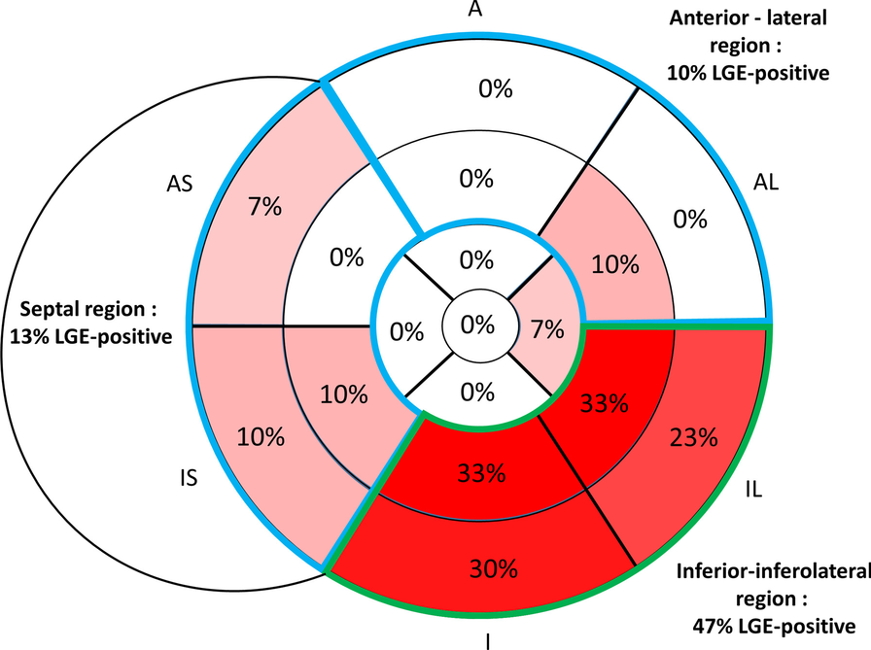
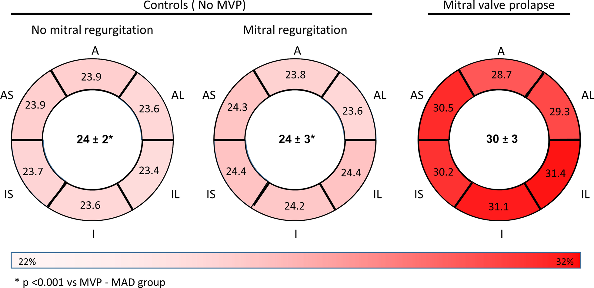
Notes:
Distribution of late gadolinium enhancement (LGE) positivity in patients with mitral valve prolapse (MVP) and MAD
Patients with MAD and MVP had higher extracellular volumes in basal segments even in the absence of gadolinium enhancement compared to patients without MAD

Slide 27
higher extracellular volumes correlated with increased risk of cardiac arrest.
Ermakov et al. published a report of 97 patients: patients with arrhythmic MVP had significantly higher mechanical dispersion compared with non arrhythmic MVP patients

Slide 28
Notes:
MAD was associated with more mitral valve surgery and younger age at aortic dissection
or prophylactic surgical repair
Patients with MAD had larger aortic root z scores and more MVP, ventricular ectopy, and NSVT

Slide 30
VPC s in MAD
RBBB morphology
Outflow / Papillary muscle / fascicular origin
In the absence of MR and Ventricular remodelling – origin of ventricular arrhythmia remains controversial
MVP-unrelated factors – like
Autonomic nervous system dysfunction , Conduction system abnormalities , Long QT , Cardiomyopathy Purkinje fibers ectopy foci
PVB from purkinjae tissue – VF trigger
LV scarring at the level of PMs with adjacent free wall in all and of the inferobasal wall in 88% of young SCD victims with MVP

Slide 31
Notes:
A, Contrast-enhanced CMR, 3-chamber view: note the midmural LGE in the LV inferobasal region under posterior valve leaflet (black arrow). B, Histopathology:
myocardial fibrosis (blue staining) at the level of the inferobasal LV free wall underneath the posterior mitral valve leaflet is visible. C, Contrast-enhanced CMR:
LGE of the PM is visible on mid short-axis view (white arrow). D, Histopathology: replacement-type fibrosis (blue staining) of the myocardium is evident at the level of the PM and adjacent free wall.

Slide 32
Ventricular arrhythmia - Mechanism
effects of MAD on arrhythmias are - likely indirect
Fibrotic changes often seen in the basal inferolateral LV and papillary muscles as a result of mechanical stretch by the prolapsing leaflets.
This scarring - substrate for anatomic or functional reentry
fibrosis in the papillary muscles of all patients with MVP and in the basal inferior wall of 88% of MVP patients
The presence of LGE with myocardial fibrosis on CMR ( independent of MVP or MAD ) has been repeatedly shown to be associated with increased rates of ventricular arrhythmias and SCD

Slide 34
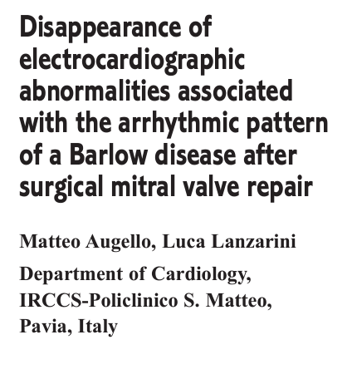
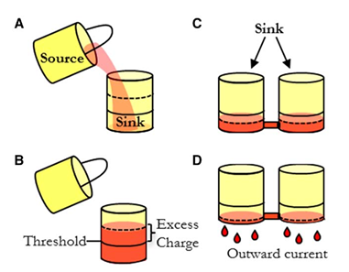
LV fibrosis alone, however, cannot explain
Italian study MVP patient with Myocardial fibrosis
abnormal mechanical motions, which potentially worsen electrical instabilities
include papillary muscle traction and systolic mitral annular expansion
disappear after surgical mitral valve repair with annuloplasty
(1) stretch-activated early after depolarizations and
(2) a “source-sink” mismatch
Notes:
who underwent successful surgical MV repair. Post-operatively, the patient had subsequent resolution of T wave inversions, a decrease in ventricular ectopy, and normalization of LV function. While myocardial fibrosis is not likely to resolve following MV surgery

Slide 35
Purkinje fibers that run through the papillary muscles are susceptible to abnormal automaticity and EAD
These triggered PVCs may utilize the adjacent Purkinje network and functional block created by a source-sink mismatch to form functional reentry.
PVC triggers are usually from purkinjae system
VA is polymorphic VT not monomorphic as in – scar mediated VA
Notes:
abnormal mechanical traction and subsequent disruption of – BIL-regional depolarization delay.

Slide 36
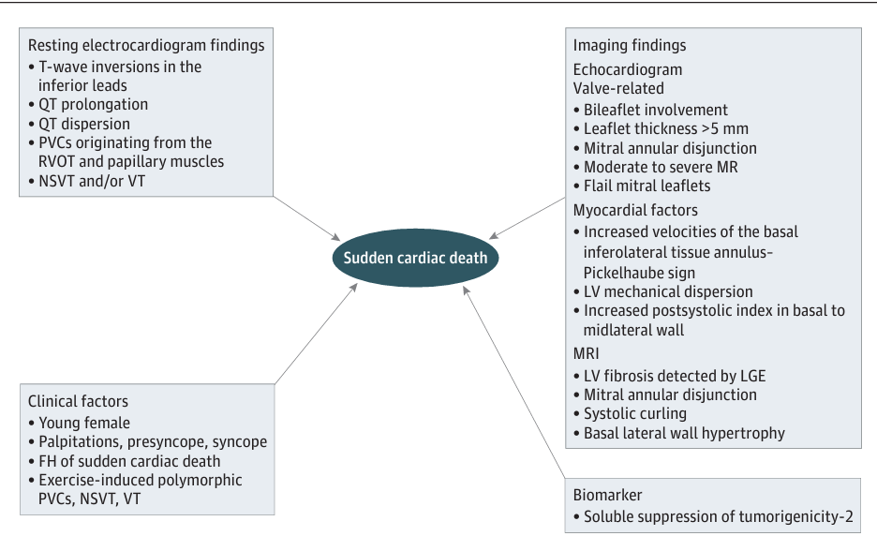

Slide 39
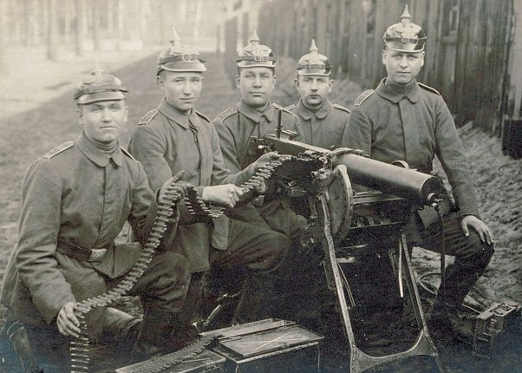

Slide 40
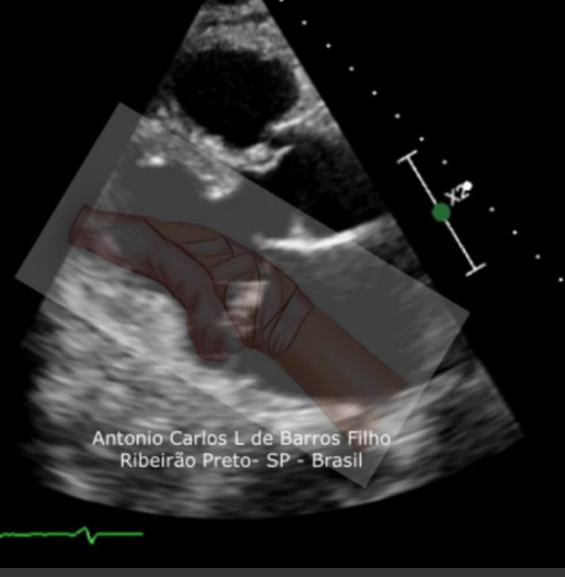
Notes:
Pickel haub sign
Ballerina foot deformity

Slide 41
Notes:
the example of the “Bull’s-eye” representation (obtained from long-axis, 2- and 4-chamber apical views) of regional strains in the MAD+ patient. Arrows present basal lateral segment with augmented (more negative) values of longitudinal strain (yellow arrow) and myocardial work index (red arrow)

Slide 42
Notes:
A,Prolapsingbileafletmyxomatousmitralvalve(arrowheads)withmitralannulusdisjunction(MAD).B,Highannulartissuevelocityof42cm/s.C,Supranormal strain(meanvalue,28%)intheposterolateraltrident,andsubnormalstraininthebasalseptalwall(meanvalue,<18%).D,Markedlyincreasedvalueofmyocardial workindexintheposterolateraltrident(meanvalue,3376mmHg%forbloodpressure[BP]of132/84mmHg;scale,red>3000mmHg%;normal[SD]value, 1896[308]mmHg%).E,Postsystolicshorteningdemonstratedinthebasalandmidlateralregions.Arrowheadsindicatepeakstrain.F,Mechanicaldispersion (SDoftimetopeak,80milliseconds).Arrowheadsindicatepeakstrain.ANTindicatesanterior;INF,inferior;LAT,lateral;POST,posterior;SEPT,septum.

Slide 43
sST2 – soluble suppression of tumorgenicity
IL-1R family member secreted by cardiac cells in response to biomechanical stress
that can promote myocardial fibrosis,
In a study of 72 patients with at least 1 mm of MAD on CMR - Patients with ventricular arrhythmias had higher average sST2 levels, lower ejection fraction, and more frequent papillary muscle fibrosis on CMR

Slide 44
MAD in Severe AS patients
Tsianaka et al reported a MAD prevalence of 7.8% among 408 patients with severe aortic stenosis who had CCT before transcatheter aortic valve
replacement.
The median MAD distance in patients with MAD was 3.5 mm
Patients with MAD
were more likely to have MVP but were no more likely to have MR or severe mitral annular calcification or to
experience atrial fibrillation/flutter, bundle branch block or atrioventricular block following transcatheter aortic valve replacement.

Slide 45
MAD and TAD
In a group of 84 patients with MAD who underwent CMR,
50% also had tricuspid annular disjunction and tended
to be older, have MVP, and have greater MAD distance
and circumferential extent. There was no association
between tricuspid annular disjunction and ventricular
arrhythmias once adjusted for age.

Slide 46
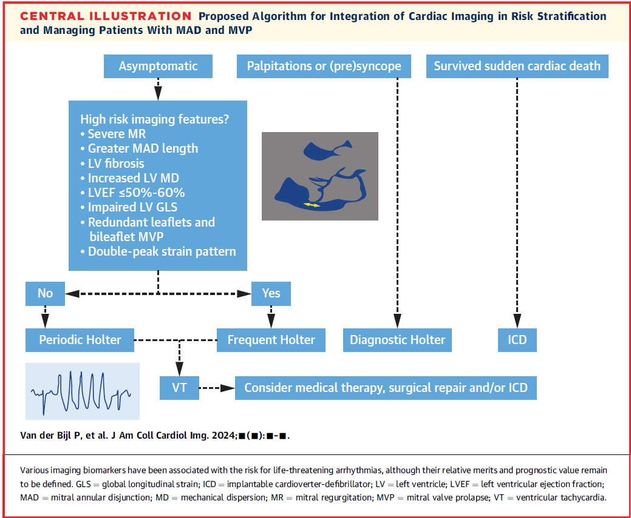

Slide 49
Sustained VT not originating from the right or left ventricular outflow tract
• Spontaneous polymorphic NSVT.
• Rapid NSVT monomorphic (>180 bpm)
Intermediate risk: This category is even less well defined. The following VAs were considered by the committee as probable intermediate risk:
• Polymorphic PVCs.
• NSVT monomorphic, of lower rate (<180 bpm).
• Highly frequent or complex PVCs (bigamy and couplets).
low risk:
with frequent PVCs but not complex VAs

Slide 51
THANK YOU

